Slide 1
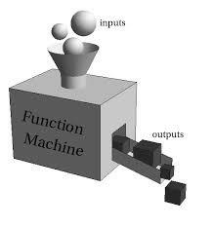
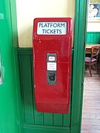
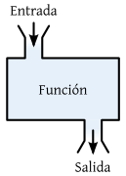
User-defined functions
User-defined functions
Arguments
Returning values
Doc Strings
Dr. Tateosian
Notes:
computers

Slide 2
Review - Describe these functions.
a. What arguments do they take?
b. Are they methods or built-in functions?
c. What do they return?
myStr = myStr.capitalize()
myList.append(5)
myList.sort()
myRange = range(1,11)
myCount = arcpy.GetCount_management(myFile)
myStr = “;”.join(myList)
Notes:
no args, returns a string (the capitalized version of original string) . It’s string method.
1 arg (the item to append), no return value (it’s alters the list itself). It’s an in place list method.
no arguments, no return value (it’s alters the list itself). It’s an in place list method.
takes 1, 2, or 3 arguments, returns a range object. It’s a built-in function.
takes 1 argument (the input file), returns a results object. It’s an arcpy method.
takes 1 argument (the list of strings to be joined), returns a string. It’s string method.

Slide 3
Describe these functions.
What arguments do they take? What do they return? Are they methods or built-in functions?
myStr = myStr.capitalize() no args, returns a string (the capitalized version of original string) . It’s string method.
myList.append(5) 1 arg (the item to append), no return value (it’s alters the list itself). It’s an in place list method.
myList.sort() no arguments, no return value (it’s alters the list itself). It’s an in place list method.
myRange = range(1,11) takes 1, 2, or 3 arguments, returns a list of numbers. It’s a built-in function.
myCount = arcpy.GetCount_management(myFile) takes 1 argument (the input file), returns a results object. It’s an arcpy method.
myStr = “;”.join(myList) takes 1 argument (the list of strings to be joined), returns a string. It’s string method.
Notes:
no args, returns a string (the capitalized version of original string) . It’s string method.
1 arg (the item to append), no return value (it’s alters the list itself). It’s an in place list method.
no arguments, no return value (it’s alters the list itself). It’s an in place list method.
takes 1, 2, or 3 arguments, returns a range object. It’s a built-in function.
takes 1 argument (the input file), returns a results object. It’s an arcpy method.
takes 1 argument (the list of strings to be joined), returns a string. It’s string method.

Slide 4
Why functions?
Computers are logic machines. If we want them to do anything, we mustprovide detailed, step by step instructions on exactly what to do. This is what a script is: a list of steps to be completed in order.
Python scripts can be hundreds of lines of code. To help structure our code and make common operations reusable, we create functions.
Notes:
Computers are logic machines. If we want them to do anything, we have to provide detailed, step by step instructions on exactly what to do. This is what a script is: a list of steps to be completed in order. Python scripts can be hundreds of lines of code. To help structure our code and make common operations reusable, we create functions.

Slide 5
What are user-defined functions?
Miniature programs inside our scripts
Useful because they can
Segment off sections of related code
Run repeated operations
Functions define code blocks, which contain the statements to be run
Examples of code inside a function:
Variable assignments, operations, conditions…

Slide 6
What do functions do?
Create a result immediately (like play a sound)
OR
Provide an answer or output to be used by other functions (return value)

Slide 7

Python functions have the same overall structure…

Slide 8
Function structure
def add(a, b):
"""Return the sum of a and b."""
result = a + b
return result
Notes:
Computers are logic machines. If we want them to do anything, we have to provide detailed, step by step instructions on exactly what to do. This is what a script is: a list of steps to be completed in order. Python scripts can be hundreds of lines of code. To help structure our code and make common operations reusable, we create functions.

Slide 9
Function structure
I'm defining a function
def add(a, b):
"""Return the sum of a and b."""
result = a + b
return result
Notes:
Computers are logic machines. If we want them to do anything, we have to provide detailed, step by step instructions on exactly what to do. This is what a script is: a list of steps to be completed in order. Python scripts can be hundreds of lines of code. To help structure our code and make common operations reusable, we create functions.

Slide 10
Function structure
name
def add(a, b):
"""Return the sum of a and b."""
result = a + b
return result

Slide 11
Function structure
def add(a, b):
"""Return the sum of a and b."""
result = a + b
return result
Indented lines of code

Slide 12

Defining a function is not the same as using a function…

Slide 13
To run a function, call it by its name
def add(a, b):
"""Return the sum of a and b."""
result = a + b
return result
total = add(5, 8)

Slide 14
To run a function, call it by its name
def add(a, b):
"""Return the sum of a and b."""
result = a + b
return result
total = add(5, 8)
Call the function
Notes:
Computers are logic machines. If we want them to do anything, we have to provide detailed, step by step instructions on exactly what to do. This is what a script is: a list of steps to be completed in order. Python scripts can be hundreds of lines of code. To help structure our code and make common operations reusable, we create functions.

Slide 15

Functions can also accept parameters and return values

Slide 16
Functions can also have parameters
Parameters
def add(a, b):
"""Return the sum of a and b."""
result = a + b
return result
total = add(5, 8)

Slide 17
Parameters
Values that you can pass to the
function when you call it
def add(a, b):
"""Return the sum of a and b."""
result = a + b
return result
total = add(5, 8)

Slide 18
Parameters
def add(a, b):
"""Return the sum of a and b."""
result = a + b
return result
total = add(5, 8)

Slide 19
Parameters
def add(a, b):
"""Return the sum of a and b."""
result = a + b
return result
total = add(5, 8)

Slide 20
Use parameters inside the function
a and b can be used inside the function
def add(a, b):
"""Return the sum of a and b."""
result = a + b
return result
total = add(5, 8)

Slide 21
Functions can also return a value
def add(a, b):
"""Return the sum of a and b."""
result = a + b
return result
total = add(5, 8)
Python keyword
Notes:
Computers are logic machines. If we want them to do anything, we have to provide detailed, step by step instructions on exactly what to do. This is what a script is: a list of steps to be completed in order. Python scripts can be hundreds of lines of code. To help structure our code and make common operations reusable, we create functions.

Slide 22
Functions can also return a value
def add(a, b):
"""Return the sum of a and b."""
result = a + b
return result
total = add(5, 8)
Value to be returned
Notes:
Computers are logic machines. If we want them to do anything, we have to provide detailed, step by step instructions on exactly what to do. This is what a script is: a list of steps to be completed in order. Python scripts can be hundreds of lines of code. To help structure our code and make common operations reusable, we create functions.

Slide 23
Functions can also return a value
def add(a, b):
"""Return the sum of a and b."""
result = a + b
return result
total = add(5, 8)
Notes:
Computers are logic machines. If we want them to do anything, we have to provide detailed, step by step instructions on exactly what to do. This is what a script is: a list of steps to be completed in order. Python scripts can be hundreds of lines of code. To help structure our code and make common operations reusable, we create functions.

Slide 24
Use an assignment to store returned value
def add(a, b):
"""Return the sum of a and b."""
result = a + b
return result
total = add(5, 8)
print(total)
Returned values can be stored
and used outside the function

Slide 25
Write a function
Write a function, compute_slope that computes the slope of a line,
given a rise and a run (assume run is not zero). Then call the function
with rise 10 and run 20.

Slide 26
Write a function
Write a function, compute_slope that computes the slope of a line,
given a rise and a run (assume run is not zero). Then call the function
with rise 10 and run 20.
def compute_slope(rise, run):
"""Return the slope
based on rise and run."""
theSlope = rise/run
return theSlope
mySlope = compute_slope(10/20)

Slide 27
To run a function, call it by its name
import stuff
def add(a, b):
"""Add a and b and return the result."""
result = a + b
return result
def multipy(a, b):
"""Print every five years between 1980 and 2005."""
yrs = range(1980,2005,5)
for yr in yrs:
print(yr)
# Do lots of other things
total = add(5, 8)
print(total)

Slide 28
Don't do this
total = add(5, 8)
def add(a, b):
"""Return the sum of a and b."""
result = a + b
return result
Notes:
Computers are logic machines. If we want them to do anything, we have to provide detailed, step by step instructions on exactly what to do. This is what a script is: a list of steps to be completed in order. Python scripts can be hundreds of lines of code. To help structure our code and make common operations reusable, we create functions.

Slide 29
Don't do this
NameError
total = add(5, 8)
def add(a, b):
"""Return the sum of a and b."""
result = a + b
return result
Notes:
Computers are logic machines. If we want them to do anything, we have to provide detailed, step by step instructions on exactly what to do. This is what a script is: a list of steps to be completed in order. Python scripts can be hundreds of lines of code. To help structure our code and make common operations reusable, we create functions.

Slide 30
Function definition before function call
total = add(5, 8)
def add(a, b):
"""Return the sum of a and b."""
result = a + b
return result
Notes:
Computers are logic machines. If we want them to do anything, we have to provide detailed, step by step instructions on exactly what to do. This is what a script is: a list of steps to be completed in order. Python scripts can be hundreds of lines of code. To help structure our code and make common operations reusable, we create functions.

Slide 31
Function must defined before calling
total = add(5, 8)
def add(a, b):
"""Return the sum of a and b."""
result = a + b
return result
Notes:
Computers are logic machines. If we want them to do anything, we have to provide detailed, step by step instructions on exactly what to do. This is what a script is: a list of steps to be completed in order. Python scripts can be hundreds of lines of code. To help structure our code and make common operations reusable, we create functions.

Slide 32
Define functions near the top of a script

Slide 33
Define functions near the top of a script

Slide 34
Call them later

Slide 35
Define your own function
def printYears():
“““Print every five years between 1980 and 2005. ”””
yrs = range(1980,2005,5)
for yr in yrs:
print yr
printYears( )
#output
1980
1985
1990
1995
2000
function definition.
Must come before (above)
function call in script
function call

Slide 36
Function syntax
What is a function? Named sequence of statements that performs a desired operation.
Near synonyms: subroutines, functions, methods
To define: Use keyword def, colon and indentation
Name can’t start with a number or contain special chars.
Define first. Then call using name and parenthesis.
‘Calling’ makes the function execute
def functionName(arg1, arg 2,… ):
#Do stuff
#calling the function
functionName(a, b, … )

Slide 37
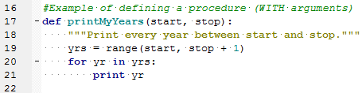
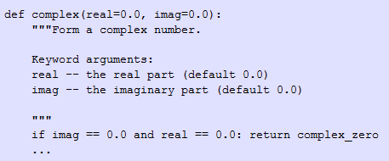
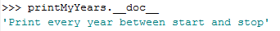
More syntax: the docstring
String literal that occurs as the first statement in the function definition
An concise explanation of function’s purpose
- one line for obvious ones
- if multi-line: use summary line (like a one-line docstring), followed by a blank line, followed by a more elaborate description.
Style notes:
Triple quotes are used even though the string fits on one line.
Use a full sentence with a period at the end.
Write as a command, not a description: “Print every year…” not “Prints every year…”
print(procName.__doc__) # Prints the document string.
( )
( )
Notes:
http://tovid.wikia.com/wiki/Python_tips/Docstrings
Notes:
Triple quotes are used even though the string fits on one line. This makes it easy to later expand it.
The closing quotes are on the same line as the opening quotes. This looks better for one-liners.
There's no blank line either before or after the docstring.
The docstring is a phrase ending in a period. It prescribes the function or method's effect as a command ("Do this", "Return that"), not as a description; e.g. don't write "Returns the pathname ...".
The one-line docstring should NOT be a "signature" reiterating the function/method parameters (which can be obtained by introspection). Don't do:
ng

Slide 38
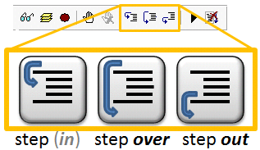
Stepping into functions
Demo

Slide 39
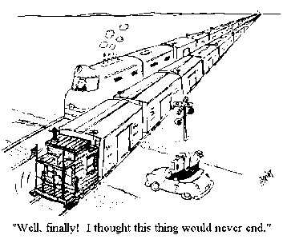
Why use functions
Save time
Eliminates the need to rewrite code.
Modularizes
By grouping a related set of code it makes your code re-useable.

Slide 40
Buffer/clip analysis code reuse example
#Buffer analysis
GET input feature.
GET buffer units.
GET buffer distance.
GET layerList.
CALL buffer on input feature.
FOR EACH layer in layerList:
SELECT features that fall within the buffer.
MAKE new feature layer from selection.
CALL read data.
CALL create html message.
CALL write HTML output.
CALL write Layer SelectionList.
CALL Zoom to selection
SET output features visible
SET non-output features not visible
CALL capture jpeg
#Clip analysis
GET input feature.
GET layerList.
CALL buffer on input feature.
FOR EACH layer in layerList:
CALL clip features that fall within the input polygon.
CALL read data.
CALL create html message.
CALL write HTML output.
CALL write Layer SelectionList.
CALL Zoom to selection
SET output features visible
SET non-output features not visible
CALL capture jpeg
Common blocks of code, such as ‘read data’ or ‘create html message’
should be written as functions so that it’s easy to reuse the code.

Slide 41
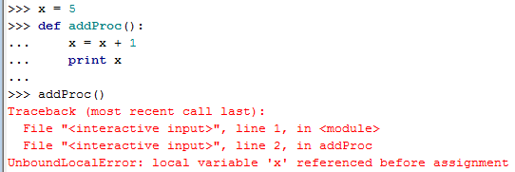
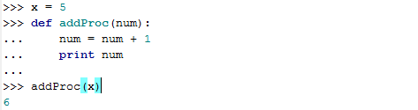
Scope: things defined outside
Need to pass variables in as a
Good practice: use different names for parameters than the variable passing in
Advanced topic: namespaces
http://docs.python.org/release/1.5.1p1/tut/scopes.html

Slide 42
Function arguments
>>> def printMyYears(start, stop):
… ‘’’Print every year between start and stop’’’
... yrs = range(start, stop + 1)
... for yr in yrs:
... print yr
...
>>> printMyYears(1920,1926)
1920
1921
1922
1923
1924
1925
1926
Notes:
DEMO 13: DEFINING & USING FUNCTIONS
***********************************
>>> # function definition
>>> def printYears():
... yrs = range(1980,2005,5)
... for yr in yrs:
... print yr
...
>>> printYears()
1980
1985
1990
1995
2000
>>> def printMyYears(start, stop, step=1):
... yrs = range(start, stop + 1, step)
... for yr in yrs:
... print yr
...
>>> printMyYears(1920,1926)
1920
1921
1922
1923
1924
1925
1926

Slide 43
In Class – printFunctions.py
The given script contains 2 function definitions and calls these functions (as examples).
1. A list of file names is given in the code (testList = ['a.shp', 'a.txt', 'cRaster']). Write code to loop through testList and print only names that end with .shp.
2. When that is working, put the looping code that you wrote for #1 inside a function definition. Pass a list in as an argument.
3. Write a line of code to call the function using testList. (The idea is to replace the code you wrote for #1 with a function definition and call.)
Notes:
>>> def myPrint(myList):
for i in myList:
if i.endswith('shp'):
print i
>>> test = ['a.shp', 'a.txt', 'cRaster']
>>> myPrint(test)
a.shp

Slide 44
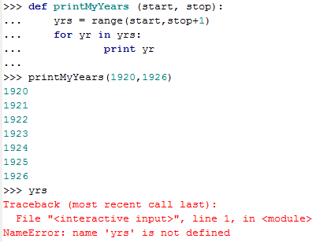
Scope: things defined inside
context in which values are associated with a variable
yrs is not defined outside the function.
need to return a value

Slide 45
Returning a value
Use return keyword.
When calling, use an assignment statement.
def functionName(arg1, arg 2,… ):
‘’’Do stuff’’’
return result
#Calling the function
x = functionName(a, b, …)

Slide 46
Example returning a value
import sys
rise = float(sys.argv[1])
run = float(sys.argv[2])
def findSlope(lineRise, lineRun):
```Return the slope of a string.’’’
lineSlope = lineRise/lineRun
return lineSlope
slope = findSlope(rise, run)
print slope

Slide 47
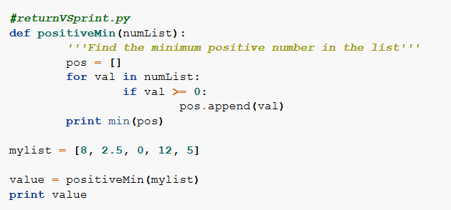
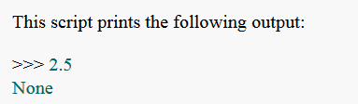
A common mistake: ‘none’
If a script prints a mysterious 'None', it often means that it is printing the return value of a function which does not contain an explicit return statement.

Slide 48
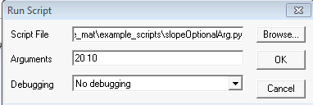
Function arguments vs. script arguments
# no arguments
def findSlope():
“““Return the …”””
lrise = 3
lrun = 4
lslope = lrise/lrun
return lslope
slope = findSlope()
print slope
# function arguments only
import sys
def findSlope(lrise, lrun):
“““Return the …”””
lslope = lrise/lrun
return lslope
rise = 8
run = 16
slope = findSlope(rise, run)
print slope
# script arguments AND function arguments
import sys
rise = float(sys.argv[1])
run = float(sys.argv[2])
def findSlope(lrise, lrun):
“““Return the …”””
lslope = lrise/lrun
return lslope
slope = findSlope(rise, run)
print slope
script arguments / function arguments – which is which?

Slide 49
In class – add5
Add another function to your script. Name the function add5. The purpose is to add five to the numeric argument passed into it and returns the result.
Call the function using an argument of 10 and set x to the result. Then print x.
Set a variable z to a float value and call the function using y as the argument and set y to the result. Then print y.
Notes:
>>> def add5( num ):
num = num + 5
return num
>>> x = add5(10)
>>> print x
15
>>> z = 3.4
>>> y = add5(z)
>>> y
8.4000000000000004

Slide 50
Optional arguments
Function arguments can be made optional.
Make options optional by assigning a default value in argument list.
Required arguments must come before optional ones.
# Define a function with optional arguments
def procName(arg1, arg2, arg3 = defaultVal1, arg4 = defaultVal2):
…
# Call a function with optional arguments
procName(a, b, c, d) #Call with 4 args
procName(a, b, c) #Or call with 3 args (defaultVal2 will be used for the last arg)
procName(a,b) #Or call with 2 args (defaultVal1 used for arg3 and defaultVal2 used for arg4)

Slide 51
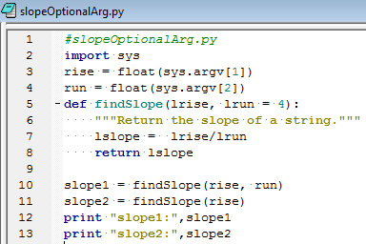
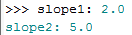
Slope Example with optional argument
optional
required
calling with 2 args
calling with 1 arg

Slide 52
In class
Modify zipAll.py so that it is a function.
The function should take one argument: the directory whose contents are to be zipped.
Call the method.

Slide 53
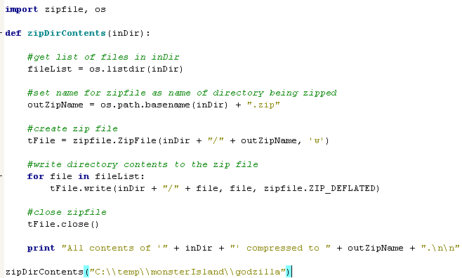

Slide 54
Amend your script…
Amend zipAllFunction so that it returns the name of the archive file that was created.

Slide 55
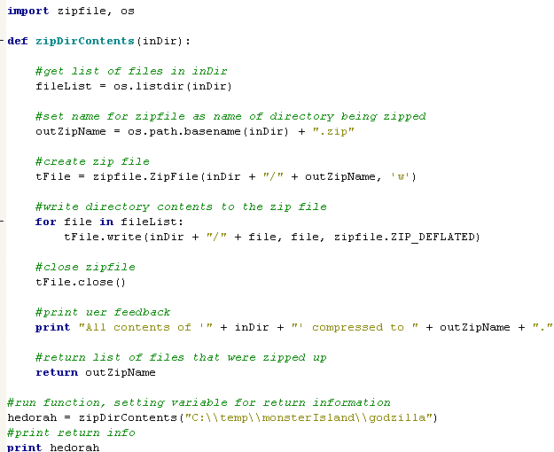

Slide 56
Summing up
Topics discussed
Function definition syntax (def keyword).
Calling functions.
Functions that take arguments.
Functions that return values.
Script arguments vs. function arguments.
Up next
cursors
Additional topics
optional arguments

Slide 57
Optional Arguments
It is possible to set some input arguments as optional by using default values.
def diffTimeReturn( start, end, message= "Time elapsed:"): difference = end - start weeks, days = divmod(difference.days, 7) minutes, seconds = divmod(difference.seconds, 60) hours, minutes = divmod(minutes, 60) print message print “””%d weeks, %d days, %d:%d:%d" %
(weeks, days, hours, minutes, seconds)”””

Slide 58
Calling the Function
>>> diffTimeReturn(begin,stop)
Time elapsed:
0 weeks, 0 days, 0:0:1
>>> mymessage = “Mothra’s travel time:
>>> diffTimeReturn(begin,stop,mymessage)
Mothra’s travel time:
0 weeks, 2 days, 0:0:6
def diffTimeReturn( start, end, message= "Time elapsed:"): difference = end - start weeks, days = divmod(difference.days, 7) minutes, seconds = divmod(difference.seconds, 60) hours, minutes = divmod(minutes, 60) print message print “””%d weeks, %d days, %d:%d:%d" %
(weeks, days, hours, minutes, seconds)”””

Slide 59
Optional Arguments
Amend your zipAll.py function so that it has an optional loop to delete all the original files after it creates the archive file

Slide 60
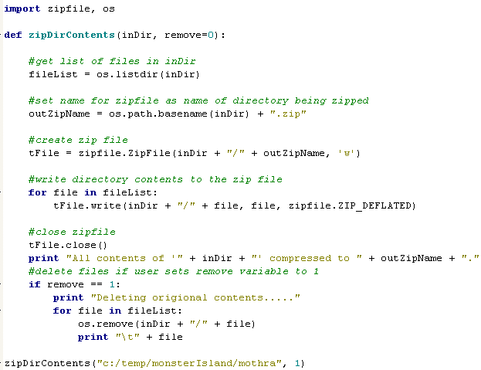

Slide 61
Returning Multiple Values
What if you need to return multiple values from a function?
def diffTimeReturn( start, end, message= "Time elapsed:"): difference = end - start weeks, days = divmod(difference.days, 7) minutes, seconds = divmod(difference.seconds, 60) hours, minutes = divmod(minutes, 60) print message print “””%d weeks, %d days, %d:%d:%d" %
(weeks, days, hours, minutes, seconds)””” return [weeks, days, hours, minutes, seconds]

Slide 62
Returning Multiple Values
Define a function that returns the extent of a shapefile before it is clipped, clips it based on a smaller file, then returns the size of the new file
Call this function, printing each extent as follows:
Old extent of in feature: xxxxxxxxxxxx
New extent of in feature: xxxxxxxxxxxx

Slide 63
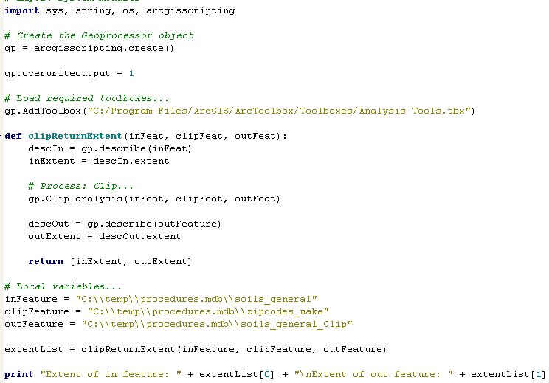

Slide 64
In class
Write a Python method that will print a given message both in PythonWin and in the geoprocessing Window when it’s called from ArcGIS
The function should take one argument: the string message to be printed
Call the method.

Slide 65
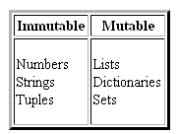
Scope: Argument values
def augment( mylist, myint ): mylist.sort() myint = myint + 1
>>> alist = [3,1,2]
>>> num = 5
>>> print alist
[3,1,2]
>>> print num
5
>>> augment(alist, num)
>>> print alist
[1,2,3]
>>> print num
5

Slide 66
Scope
scope: context in which values are associated with a variable
import datetime, time x = 5 def reportTime( ): #Report the current time x = x + 1 t = datetime.datetime.now( ) # Get a datetime object print t.ctime( ) # Print the date time
print x reportTime( )
>>> 5
Traceback (most recent call last):
UnboundLocalError: local variable 'x' referenced before assignment

Slide 67
Scope: NameError
designates the context in which values are associated with a variable
import datetime, time z = 5 def reportTime(x): #Report the current time x = x + 1 t = datetime.datetime.now( ) # Get a datetime object print t.ctime( ) # Print the date time
reportTime(z) print t
>>> Traceback (most recent call last):
NameError: name 't' is not defined

Slide 68
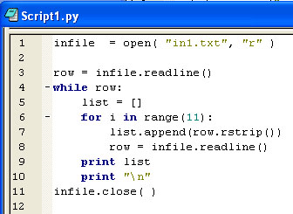
Review
List the line numbers that call functions
Decide if the function is a built-in function, a string method, a list method, or other
Notes:
1 open is a built-in function
3 readline is a file method
6 range is a built-in function
7 append is a list method; rstrip is a string method
8 readline is a file method
11 close is a file method

Slide 69
Review
Capitalize myStr (a Python string)
Append 5 to myList (a Python list)
Sort myList (a Python list)
Find the record count of myFile (a full path shapefile name). Store the result in a variable named myCount. Assume arcpy is already imported.
Notes:
myStr = myStr.capitalize()
myList.append(5)
myList.sort()
myCount = arcpy.GetCount_management(myFile)

